Slide 1

Cache Mapping and Its Techniques

Slide 2
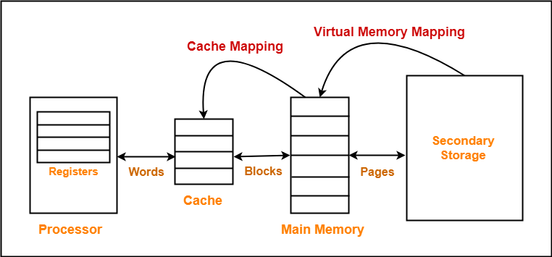
Cache Mapping
Cache mapping defines how a block from the main memory is mapped to the cache memory in case of a cache miss.
OR
Cache mapping is a technique by which the contents of main memory are brought into the cache memory.

Slide 3
Important Points
Main memory is divided into equal size partitions called as blocks or frames.
Cache memory is divided into partitions having same size as that of blocks called as lines.
During cache mapping, block of main memory is simply copied to the cache and the block is not actually brought from the main memory

Slide 4
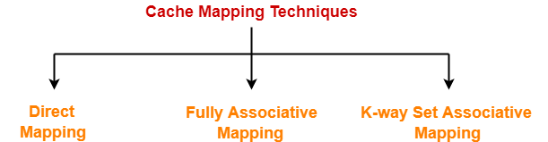
Cache Mapping Techniques
Direct Mapping
Fully Associative Mapping
K-way Set Associative Mapping

Slide 5
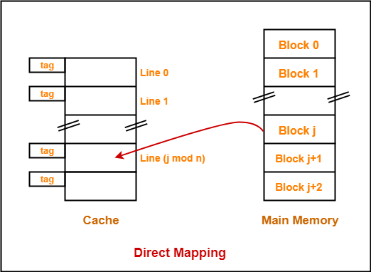
Direct Mapping
In direct mapping, a particular block of main memory can map only to a particular line of the cache.
The line number of cache to which a particular block can map is given by-
Cache line number
= ( Main Memory Block Address ) Modulo (Number of lines in Cache)
Consider cache memory is divided into ‘n’ number of lines.
Then, block ‘j’ of main memory can map to line number (j mod n) only of the cache.

Slide 6
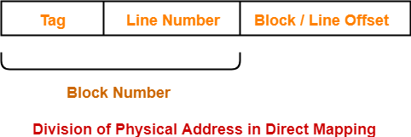
Division of Physical Address
In direct mapping, the physical address is divided as-

Slide 7
Working of Direct Mapping
The following steps explain the working of direct mapped cache-
After CPU generates a memory request,
The line number field of the address is used to access the particular line of the cache.
The tag field of the CPU address is then compared with the tag of the line.
If the two tags match, a cache hit occurs, and the desired word is found in the cache.
If the two tags do not match, a cache miss occurs.
In case of a cache miss, the required word has to be brought from the main memory.
It is then stored in the cache together with the new tag replacing the previous one.

Slide 8
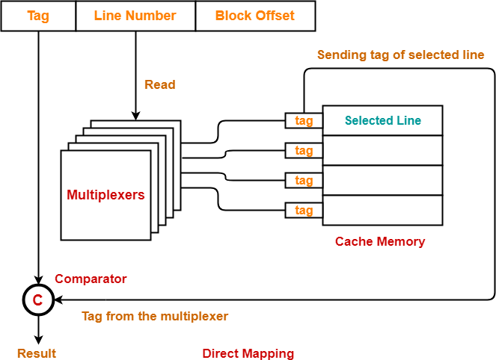
Implementation of Direct Mapping
The following diagram shows the implementation of direct mapped cache
Step-01:
Each multiplexer reads the line number from the generated physical address using it select lines in parallel.
To read the line number of L bits, number of select lines each multiplexer must have = L.
Step-02:
After reading the line number, each multiplexer goes to the corresponding line in the cache memory using its input lines in parallel.
Number of input lines each multiplexer must have = Number of lines in the cache memory

Slide 9
Implementation of Direct Mapping
Step-03:
A multiplexer outputs a tag bit that it selects from that to the comparator with the help of its output line.
The total number of output lines present in each multiplexer should be equal to 1.
Step-04:
Comparator compares the tag coming from the multiplexers with the tag of the generated address.
Only one comparator is required for the comparison where-
Size of comparator = Number of bits in the tag
If the two tags match, a cache hit occurs otherwise a cache miss occurs.

Slide 10
Important Points of Direct Mapping
Following are the few important results for direct mapped cache-
Block j of main memory can map to line number (j mod number of lines in cache) only of the cache.
Number of multiplexers required = Number of bits in the tag
Size of each multiplexer = Number of lines in cache x 1
Number of comparators required = 1
Size of comparator = Number of bits in the tag
Hit latency = Multiplexer latency + Comparator latency

Slide 11
Important Formulas of Direct Mapping
Line Size = Block Size
No. of lines in cache = Cache Size/Line Size
No. of blocks in main memory = Main Memory Size/Block Size
No. of bits in Physical Address = Tag Number bits + Line Number bits + Block/Line Offset bits
Block Size = 2^(No. of bits in block offset)
Main Memory Size = 2^(No. of bits in Physical address)
Tag Directory Size = Number of lines in cache x Number of bits in tag.
2^(No. of Tag bits)= Main Memory Size/ Cache Size
Number of cache indexing bits = 2^(Number of lines in cache)

Slide 12
Problems on Direct Mapping
Q1 Consider a direct mapped cache of size 16 KB with block size 256 bytes. The size of main memory is 128 KB. Find-
Number of bits in tag
Tag directory size
Q2. Consider a direct mapped cache of size 512 KB with block size 1 KB. There are 7 bits in the tag. Find-
Size of main memory
Tag directory size
Q3. Consider a direct mapped cache with block size 4 KB. The size of main memory is 16 GB and there are 10 bits in the tag. Find-
Size of cache memory
Tag directory size
3. No. of physical address bits
4. No. of bits in block offset

